Slide 1

Implement a Natural Language Processing Application
Student Name: Marwan Al Farah
Student ID: 21110011
Section Number: 3
Instructor Name: Eng. Yara Alharahsheh

Slide 2
Data Pre-Processing

Slide 3
Pre-Processing Steps – Loading the Dataset
The loading of training (temp) and testing datasets is done from Excel files through pandas library.
To guarantee randomness and reproducibility, the data are shuffled with a fixed random state, and indices are reset since they are close to being ordered by the target value.

Slide 4

Pre-Processing Steps – Cleaning the Text
A function, clean_text, is created for text cleaning that involves:
Substituting underscores with spaces.
Cutting down on characters repeated more than twice.
The process involves taking out Arabic diacritics (like Fatha, Damma, Kasra, etc...) through regular expressions.
Removing punctuation and stripping whitespace.
Normalizing all forms of Arabic letters be the same.
Removing English letters and digits.
We will also tokenize the text and get rid of Arabic stopwords.
All this is done on the 'News'column found in both the training dataset (temp) as well as the testing dataset.

Slide 5
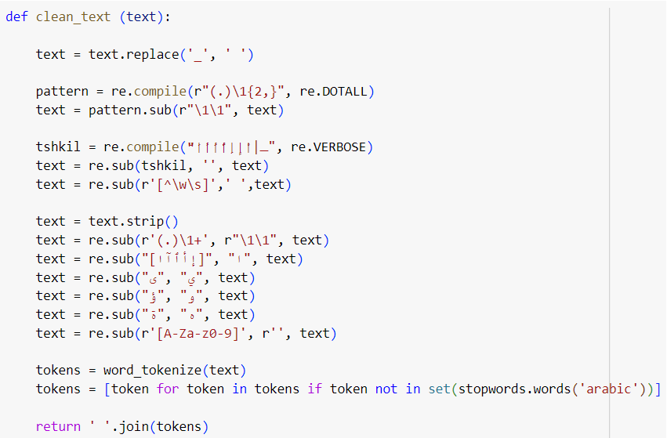
Pre-Processing Steps – Cleaning the Text

Slide 6



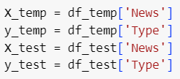

Pre-Processing Steps – Data Encoding and Splitting
The target variables are later encoded using LabelEncoder which plays a pivotal role in transforming categorical labels into a numerical format. This transformation is critical during the model training phase as certain models do not accept the raw labels but rather require them to be numerical (e.g. BiLSTM, BERT, GPT).
After performing these pre-processing steps, the data sets were divided into independent variables and dependent variables.
An 80-20 ratio was used to split the training feature and target variables (temp) into training and validation sets, maintaining a constant random state for reproducibility.

Slide 7
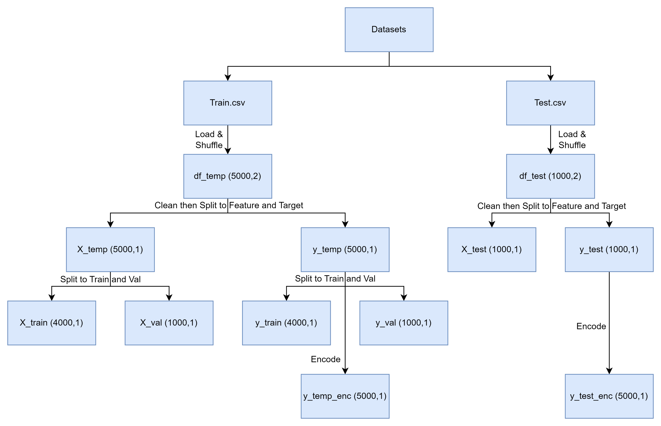
Pre-Processing Steps – Pipeline

Slide 8
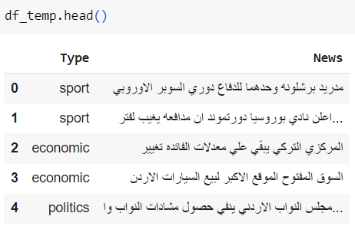
Pre-Processing Steps
As we can see, the results from the pre-processing steps are highly understandable, clean, and can be used to represent our words in various ways later on.

Slide 9
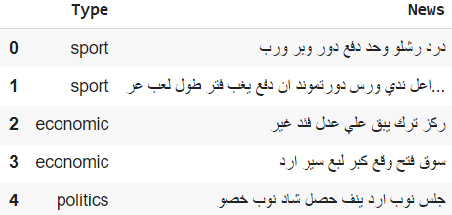
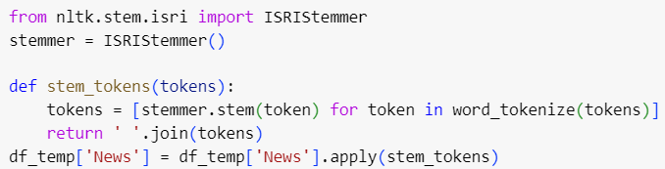
Pre-Processing Steps – Other Tested Steps
We also tried to use stemming using NLTK's ISRIStemmer, which proved to perform poorly as even as an Arabic speaker I couldn't understand what was meant by the sentence. Additionally, the stemmer resulted in OOV for the majority of the tokens when using pre-trained word embeddings, therefore, we dropped the stemming step from our preprocessing.

Slide 10
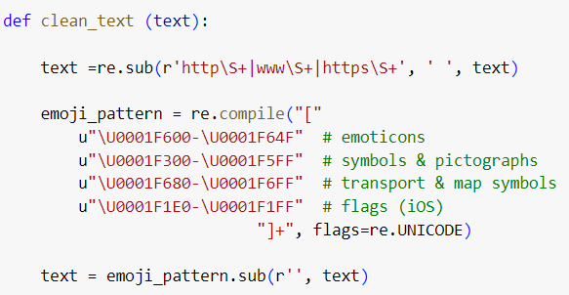
Pre-Processing Steps – Other Tested Steps
Initially, we included in the clean_text function a step to remove all emoticons and URLs from the text, but after double checking for their exitance, it was apparent that the text was clear from both of them.

Slide 11
Pre-Processing Steps – Packages Used
pandas - A library utilized for data manipulation and analysis due to its capability of reading data from different file formats such as Excel through functions, enabling manipulation of data frames and compatibility with other packages.
re (Regular Expression) - It is employed for tasks that involve text cleaning, which include but are not limited to removing diacritics, replacing characters (any activity with normalization and typically asking for pattern matching).
nltk (Natural Language Toolkit) - It plays an important role in text processing through tokenization and stopwords removal; designed especially for tasks on natural language processing.
sklearn (scikit-learn) - The dataset was split into training and validation sets using sklearn, and the categorical labels were transformed into a numeric format, which is necessary for model training.

Slide 12
Evaluation of Pre-Processing Steps
Shuffling and Resetting Index: This step should mitigate any bias that might occur due to any inherent order in the dataset, such as chronological listing or category-based clustering, by changing the dataset order randomly and resetting the index, which will help in making our dataset more appropriate to produce unbiased machine learning applications., thus its performance should be representative of its ability to work with real unsorted data typically encountered by models in practice.
Normalization and Cleaning: The cleaning process implemented is deals with various common issues in text data, particularly in Arabic (such as removing underscores, normalizing repeated characters, having various representations of the same letter, and getting rid of diacritical marks) which is necessary to simplify the language model by reducing the number of unique tokens it needs to learn, which would help make the model more capable of capturing meaningful patterns from the data more easily due to fewer distractions.

Slide 13
Evaluation of Pre-Processing Steps
Removal of Non-textual Elements: Removing numerical values, English alphabet letters, puctuation, and other symbols (except letters Arabic letters) can assist the algorithm in concentrating solely on textual information. This is notably crucial in tasks like classification, where the meaning of words and their relationships are more important than any other non-textual features.
Tokenization and Stopword Removal: One of the fundamental procedures in text processing, tokenization and stopword removal has a profound effect on efficiency. The Arabic language is highly inflected and thus, proper tokenization along with elimination of stopwords can significantly improve quality since these are largely recurrent but not meaningful words, therefore, by removing them, we allow the training model to concentrate on more essential textual features that can better serve the purpose of classification.

Slide 14
Evaluation of Pre-Processing Steps Used
Feature and Target Split: explicitly separating the dataset into feature and target variables is critical for making the code more accessible and understandable to the user.
Train Test Split: Having four different types of datasets (temp, train, val, and test) is essential since each will be used at some time. For example, while working with our baseline model, we will use the "train" dataset for training and the "val" dataset for evaluation, however, after determining the best word representation using our baseline model, we will use the "temp" dataset for training and the "test" dataset for evaluation.
Label Encoding: Encoding the "temp" and "test" target variables was necessary for the modeling stage because in order to use the BiLSTM, BERT, and GPT, our target variable have to be encoded, however, because we will not be using these three models until after we have chosen our best word representation using our baseline model, we do not need to encode either the "train" nor the "val" target variables, reducing the code's space requirements.

Slide 15
Evaluation of Packages Used - pandas
Pandas is a well-known python library, known for its robust data manipulation capabilities, which is crucial during the preprocessing phase of any data science project.
This feature allows it to read data from a variety of file formats, including Excel, making it simple for users to connect their various data sources, which was very useful when dealing with the news headline information in Excel format.
Moreover, the DataFrames provide by Pandas are strong data structures. This means that work with data manipulation, starting from simple actions like filtering or sorting to more complex aggregations, is intuitive and easy-to-perform and was very useful for our project.
Compatibility of Pandas with other Python libraries used in the project contributes to smooth workflow which in turn plays a critical role in preserving both integrity and velocity throughout the data pre-processing and analysis flow.

Slide 16
Evaluation of Packages Used - re
The re module is very useful when dealing with complicated manipulations of text, particularly when working on NLP tasks where textual information typically needs to be thoroughly cleaned and normalized.
In the context of Arabic text processing, re was greatly needed for tasks such as removing diacritics, which are very abundant in Arabic script and can lead to inconsistencies in textual data.
Development of distinctive patterns to substitute or eliminate undesired characters enables a personalized technique to data pre-processing which is integral in maintaining cleanliness and consistency of data before feeding it into the model.
This feature plays a crucial role in ensuring the accuracy of the subsequent machine learning models; because noisy data could substantially inhibit model performance.

Slide 17
Evaluation of Packages Used - nltk
One of the primary NLP libraries in Python, NLTK provides a wide range of tools for text processing. These tools are essential in cleaning and preprocessing textual data for machine learning purposes. Among the features that played a key role in this work were its functions for tokenization and stopword removal.
Tokenization is the process of converting raw text into a structured form (separating words from each other and from punctuation), which is necessary for machine learning models to comprehend.
Removing stopwords plays a role in reducing the dimensionality of the dataset and allowing the model to concentrate only on words that carry the actual needed meaning.
NLTK's supports multiple languages (among them Arabic) which ensures that preprocessing steps are done as effectively as possible which is key when building robust NLP systems.

Slide 18
Evaluation of Packages Used - sklearn
Scikit-learn, an important tool for a machine learning professional: simple, efficient, compatible with many Python libraries and known for its simplicity and efficiency. Its use in this project primarily revolved around its role in data splitting and label encoding.
Data splitting functionality provided by sklearn is useful when creating a reliable training set from which we can validate our model evaluation.
Some models require the conversion of categorical labels into numbers before to be able to train them, which can be accomplished simply using scikit-learn's LabelEncoder class.
Scikit-learn is a great option for academic and industrial applications where scalable and maintainable code is crucial because of its resilience and simplicity of usage.

Slide 19
Evaluation of Packages Used
This combination of these libraries formed a solid base that allowed us to deal with the Arabic news headline data sets effectively, thereby enabling work on NLP-related tasks within a sound framework.
When utilized together, it did not only make the workflow smoother but it also increased the ability of producing advanced models that are characterized by accuracy as well as efficiency.
The analysis highlights the critical role of tool selection in machine learning project development with a special focus on projects involving complex textual data such as Arabic news headlines.
The real world usefulness of these tools is that they help to improve accuracy and efficiency of an NLP classification model, such as ours, thus illustrating their important role in the successful implementation of NLP tasks.

Slide 20
Word Representation Techniques

Slide 21
Word Representation Techniques
When selecting among traditional word representation techniques such as TF-IDF, Bag-of-Words (BoW), n-gram, and one-hot encoding, TF-IDF and BoW were chosen.
When it came to independent context word embedding, there were eight Word2Vec versions to choose from (Twitter vs. Wikipedia, CBoW vs. SkipGram, and vector sizes of 100 vs. 300), as well as FastText. The two pre-trained word embeddings used were two variants of Word2Vec, both with a vector size of 300 and employing CBoW, but with different training data (Twitter and Wikipedia).
Additionally, BERT was chosen as a dependent context word embedding.

Slide 22
Rationale for Choosing Word Representations
TF-IDF: It adjusts to the inverse document frequency, in order to highlight terms that are valuable. It has been found useful in text classification where it plays a role as a strong feature extraction baseline. Compared to n-gram and one-hot encoding, it is able to produce fewer features which helps in dealing with high dimensionality and sparsity.
BoW: It converts text into numerical features without taking into account the word order, which makes it easier for implementation and interpretation since no consideration of sequences needs be done. BoW can thus be used as a basic technique upon which more sophisticated representations can be evaluated against.
Word2Vec (Twitter): Derived from Twitter data, the 300-dimensional CBoW model effectively captures contextual meanings, making it suitable for colloquial and formal languages used in social media and news contexts.
Word2Vec (Wikipedia): These 300-dimensional CBoW vectors are capable of representing semantic relationships. They provide great representations because they are trained on the Wikipedia corpus, a large, carefully curated corpus that covers a wide range of topics and is often written in a formal style.
BERT: It introduces context-sensitive embeddings, which means they can capture meanings depending on the surrounding context. To get an accurate understanding of text, bidirectional encoding takes into account both the left and right contexts. It regularly outperforms other models across a range of NLP metrics.

Slide 23
Comparison of Word Representation Techniques
Feature | TF-IDF | Bag-of-Words | Word2Vec (Twitter) | Word2Vec (Wikipedia) | BERT
Description | Converts text into a numerical form by measuring the importance of a term | Simple count of words in a document, creating a sparse matrix | Pre-trained embeddings from Twitter data | Pre-trained embeddings from Wikipedia data | Pre-trained model generating contextual embeddings using Transformer architecture
Dimensionality | High-dimensional depending on the corpus | High-dimensional depending on the corpus | High and Fixed dimensions (e.g., 300 for the model used) | High and Fixed dimensions (e.g., 300 for the model used) | High and Fixed dimensions (e.g., 768)
Sparsity | Sparse matrix | Very sparse matrix | Dense matrix | Dense matrix | Dense matrix
Handling OOV Words | Can only handle words seen during training | Can only handle words seen during training | Can't handle OOV words | Can't handle OOV words | Handles OOV words by using WordPiece Tokenizer that breaks tokens down into subwords or using special tokens

Slide 24
Comparison of Word Representation Techniques
Feature | TF-IDF | Bag-of-Words | Word2Vec (Twitter) | Word2Vec (Wikipedia) | BERT
Context Sensitivity | Lacks context sensitivity, focuses on document-level word frequencies | Lacks context sensitivity, focuses on document-level word frequencies | Limited context sensitivity as embeddings capture some semantics | Limited context sensitivity as embeddings capture some semantics | Highly context-sensitive, understanding the meaning based on surrounding text
Performance | Effective for many standard tasks, depends on corpus and task specifics | Generally less effective than more advanced methods | Depends on the quality and relevance of pre-trained embeddings | Depends on the quality and relevance of pre-trained embeddings | Typically leads to advanced performance on many NLP tasks due to deep understanding of language structure and context
Usage | Widely used in traditional ML models | Widely used in traditional ML models | Common in deep learning models where pre-trained embeddings help | Common in deep learning models where pre-trained embeddings help | Essential for modern NLP applications, especially in fine-tuning tasks and scenarios requiring deep semantic understanding
Training Requirement | Training is based on statistical data of the corpus | Training is based on statistical data of the corpus | No additional training required if using pre-trained models | No additional training required if using pre-trained models | Requires significant computational resources for training, since pre-trained models are often fine-tuned with additional task-specific data for best results

Slide 25
Baseline Model
It was important to pick a baseline model for comparing different word representations, and we picked Naïve Bayes as our baseline model for the following reasons:
Simplicity and Efficiency: Naïve Bayes is simple and computationally efficient, allowing fast testing with different word representations.
Probabilistic Foundation: It is built on Bayes’ Theorem, which equips it with a strong classification framework that can manage tasks effectively through its assumption of independence.
Strong Baseline: Naïve Bayes is an excellent baseline in text classification even with a large number of features because it performs well despite the strong feature independence assumption.
Interpretable Outputs: Naïve Bayes results are straightforwardly interpretable which provides easy understanding on how well different word representations work.

Slide 26
Results of Different Word Representations with the Baseline Model
Word Representation | Accuracy | Macro Average Precision | Macro Average Recall | Macro Average F1-Score
TF-IDF | 58% | 53% | 70% | 51%
Bag-of-Words | 57% | 53% | 70% | 51%
Word2Vec (Twitter) | 89% | 76% | 90% | 79%
Word2Vec (Wikipedia) | 87% | 74% | 89% | 77%
BERT | 89% | 77% | 84% | 79%

Slide 27
Results of Different Word Representations with the Baseline Model
Although TF-IDF and Bag-of-Words achieve comparable performance metrics showing low accuracy and F1-score values when compared to other models, however, Their recall is relatively high but their precision suffers as it is lower.
The performance of Word2Vec (Twitter) is significantly enhanced with respect to all metrics, especially the recall and F1 score. This implies that there is a better grasp of contextual meanings and semantic relationships within the data.
Although not as effective as the Twitter model, Word2Vec (Wikipedia) still shows strong performance which suggests that the Word2Vec embeddings are able to capture rich information even when trained from different sources like Wikipedia.
BERT stands out with high accuracy, recall, and F1-scores similar to Word2Vec (Twitter), confirming its better capability in understanding context, which adds to its high performance in classifying the news articles.

Slide 28
Continuing with BERT
Although the macro F1-score and accuracy levels of BERT and Word2Vec (Twitter) were identical, we chose to proceed with our modeling with the BERT embeddings. This choice was made after looking at all the performance metrics (precision and recall as well as f1 score and accuracy) for all the classes, as well as their macro averages, which have an impact on the robustness of the model, particularly for minority classes. Important things taken into account were:
BERT was able to achieve higher F1 scores for the minority classes compared to Word2Vec, showing its superiority in addressing class imbalances while also providing better context understanding.
On the other hand, BERT excels at understanding context because of its use of a transformer architecture, meaning it is much more efficient when dealing with tasks that require semantic meaning.
Not only does BERT show flexibility by adapting well to changes in data and scope of projects but this adaptability also allows continuous improvement which could be beneficial in the future.

Slide 29
Analysis of the NLP Models

Slide 30
NLP Models
We chose Naïve Bayes and SVM when choosing traditional machine learning algorithms to predict classes of news headlines.
Among the NLP neural network models, we considered RNNs, LSTMs, GRUs and their bidirectional variants, however our choice fell on Bidirectional LSTM.
For advanced transformer-based models, we picked BERT and GPT.

Slide 31
Rationale for Choosing Models
Naïve Bayes: Simple approach that excels in text classification, boosted by BERT embeddings for even greater accuracy. Simplicity makes it ideal for comparison with more complex models, ensuring fair evaluation. Retrained and tested on the same data as other models for unbiased results.
SVM: It does well in handling the complex text data by using the BERT embeddings effectively. It establishes distinct decision boundaries that enhance accuracy and strength of classification, thus avoiding the curse of dimensionality typically resulting from high-dimensional spaces where overfitting tends to occur.
Bidirectional LSTM: It processes text in two directions (from the beginning to the end and vice versa). It results in an overall understanding of text data, particularly when used in conjunction with BERT. This technique is very efficient for sequences since it helps in capturing the context, and because of its bidirectional nature and use of embeddings from BERT, it should exhibit good results.
BERT: Uses a bidirectional approach to be able to come up with a good context analysis that will then significantly enhance the classification system. Because of its unique structure and large amounts of data used during training, it achieves top performance levels in tasks related to text classification, by identifying hidden commonalities beyond surface similarities between words which results in having more accurate predictions.
GPT: Its ability for sequence prediction allows it to understand language at a deep level even in the lack of BERT embeddings, leading to superior classification. This is why it does very well in text classification, text generation, and managing complicated language patterns. This sets itself apart as an alternative perspective towards context and sequential modeling compared to other transformer models; thereby presenting a detailed analysis on different grounds with these advanced transformer models.

Slide 32
Comparison Between Models
Aspect | Naïve Bayes | SVM | Bidirectional LSTM | BERT | GPT
Embedding Used | BERT Embeddings | BERT Embeddings | BERT Embeddings | None | None
Primary Approach | Probabilistic | High-Dimensional Space Management | Sequential Data Modeling with Bidirectional Context | Deep Bidirectional Training | Generative Pre-trained Transformer
Handling High Dimensions | Effective with simplicity | Excels with well-defined decision boundaries | Manages high-dimensional sequential data | Robust and nuanced context understanding | Strong in sequence classification and generation
Contextual Understanding | Limited to unigram probabilities | Strong through decision boundaries and support vectors | Strong bidirectional context understanding | Deep bidirectional context comprehension | Versatile language understanding through generation
Training and Evaluation | Retrained on X_temp, evaluated on X_test for fairness | Trained on X_temp, evaluated on X_test | Trained on X_temp, evaluated on X_test | Trained on X_temp, evaluated on X_test | Trained on X_temp, evaluated on X_test
Strengths | Simplicity, solid baseline performance | Robust against overfitting, effective for text data | Effective for sequential data, captures bidirectional dependencies | State-of-the-art performance, captures nuanced relationships | Excels in text generation, versatile language understanding
Weaknesses | Limited in capturing complex dependencies | Requires careful tuning of hyperparameters | Computationally intensive, requires large datasets | Computationally intensive, requires significant resources | Computationally intensive, requires significant resources

Slide 33
Results – Accuracy and Macro Averages
Model | Precision (Macro Avg) | Recall (Macro Avg) | F1-Score (Macro Avg) | Accuracy
Naïve Bayes | 0.83 | 0.81 | 0.82 | 0.85
SVM | 0.88 | 0.75 | 0.78 | 0.85
BiLSTM | 0.88 | 0.80 | 0.83 | 0.87
BERT | 0.90 | 0.82 | 0.85 | 0.89
GPT | 0.90 | 0.79 | 0.82 | 0.87

Slide 34
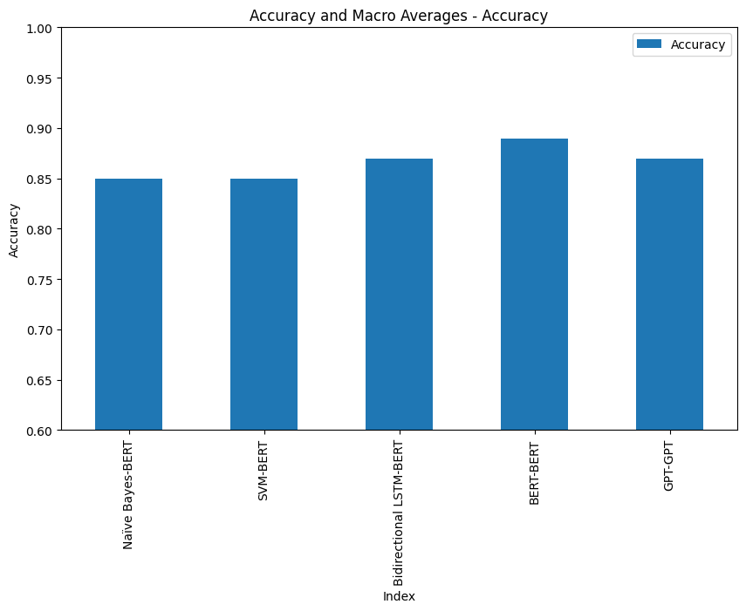
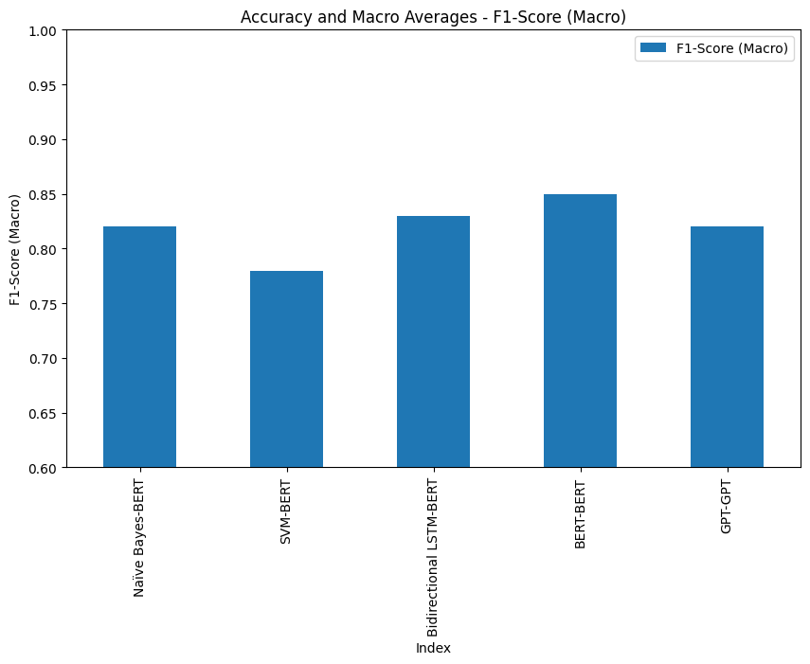
Results – Accuracy and Macro Averages

Slide 35
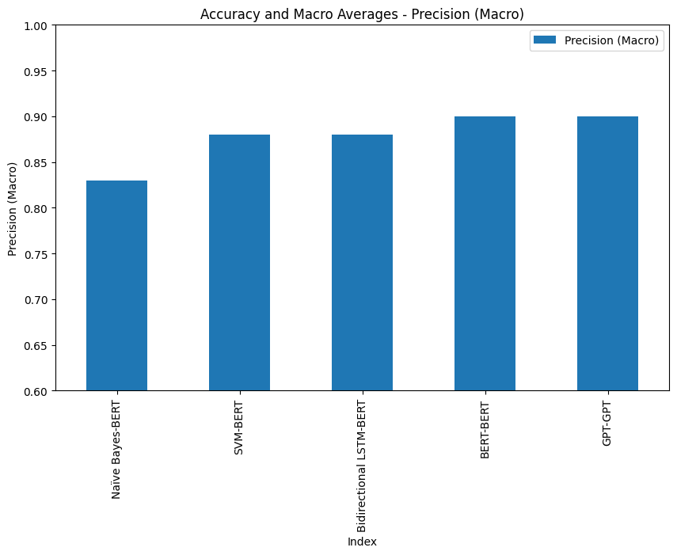
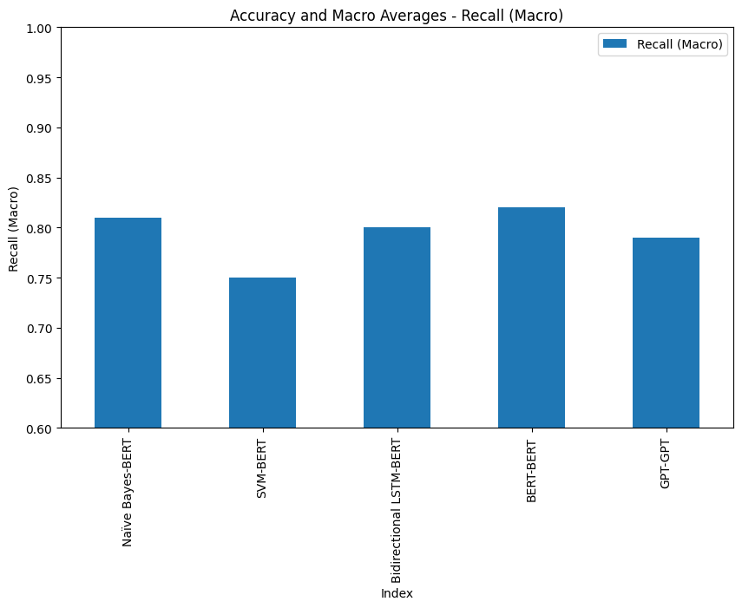
Results – Accuracy and Macro Averages

Slide 36
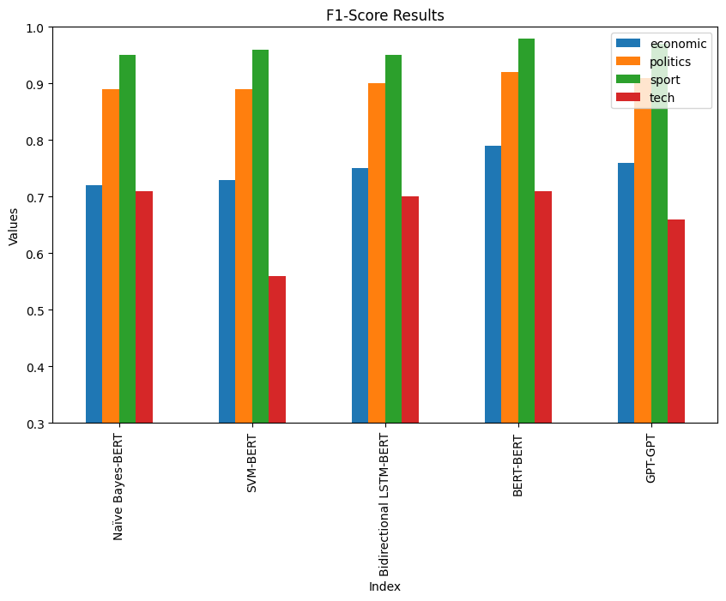
Results – F1-Score
 | economic | politics | sport | tech
Naïve Bayes | 0.72 | 0.89 | 0.95 | 0.71
SVM | 0.73 | 0.89 | 0.96 | 0.56
BiLSTM | 0.75 | 0.9 | 0.95 | 0.7
BERT | 0.79 | 0.92 | 0.98 | 0.71
GPT | 0.76 | 0.91 | 0.97 | 0.66

Slide 37
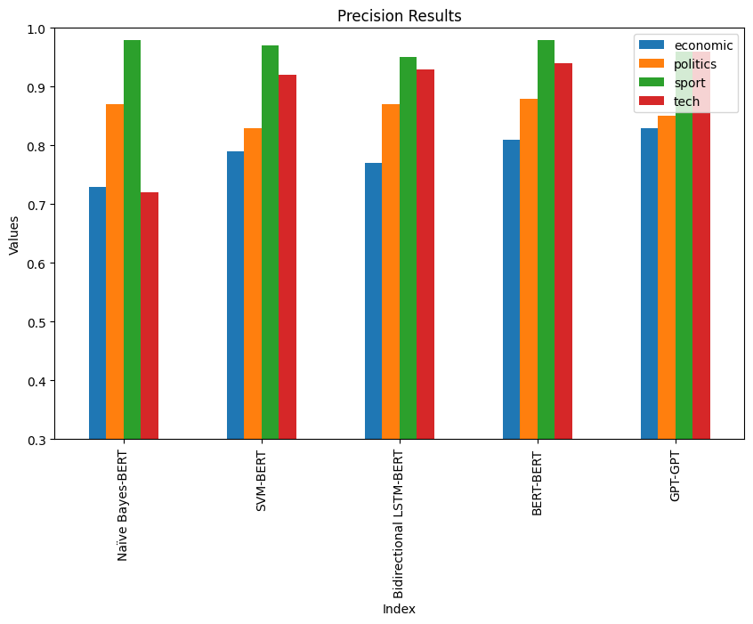
Results – Precision
 | economic | politics | sport | tech
Naïve Bayes | 0.73 | 0.87 | 0.98 | 0.72
SVM | 0.79 | 0.83 | 0.97 | 0.92
BiLSTM | 0.77 | 0.87 | 0.95 | 0.93
BERT | 0.81 | 0.88 | 0.98 | 0.94
GPT | 0.83 | 0.85 | 0.96 | 0.96

Slide 38
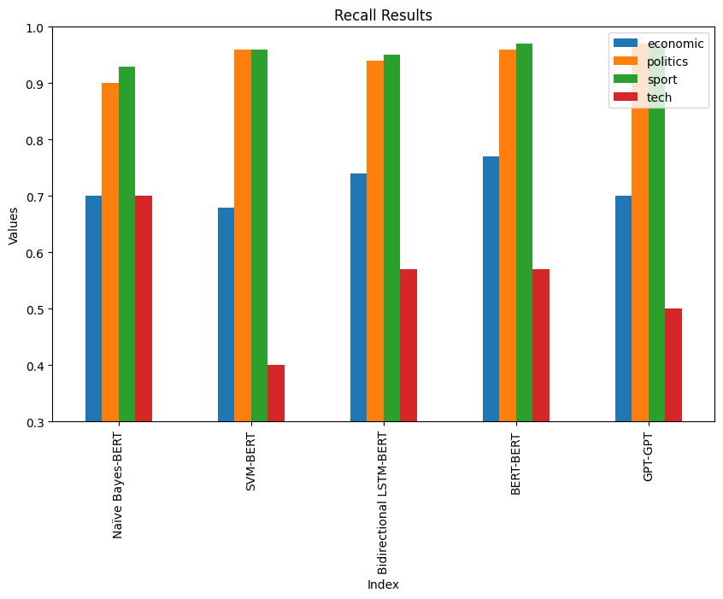
Results – Recall
 | economic | politics | sport | tech
Naïve Bayes | 0.7 | 0.9 | 0.93 | 0.7
SVM | 0.68 | 0.96 | 0.96 | 0.4
BiLSTM | 0.74 | 0.94 | 0.95 | 0.57
BERT | 0.77 | 0.96 | 0.97 | 0.57
GPT | 0.7 | 0.97 | 0.97 | 0.5

Slide 39
Main Findings
BERT emerged as the top performer with the highest overall accuracy and f1-score with balanced performance across all categories. It is particularly effective for text categorization jobs because of its strong understanding of context and adaptability in applying its learned information to various scenarios.
Naïve Bayes and SVM performed very well in categories with various linguistic patterns (like "politics" and "sport"). However, they didn't perform as well in more complicated areas like "tech." These models benefit from simplicity and speed but may require more complicated feature architecture.
BiLSTM and GPT models fared well, with BiLSTM showing great performance in most classifications and GPT standing out when it came to news connected to politics and sport. These models are strong due to their capacity to retain sequential and contextual awareness, but they need computing power resources to operate and might need efforts in fine-tuning.
Better feature representation or more specialized training data may be necessary to adequately capture the ‘tech’ class, as it consistently demonstrated worse performance across various models.

Slide 40
Strengths and Weaknesses – Naïve Bayes
Strengths:
It is very simple to implement, along with being computationally efficient, as well as performing well in categories with distinct language patterns, such as 'politics' (f1-score: 0.89) and 'sport' (f1-score: 0.95).
Weaknesses:
Struggles with categories that have nuanced language patterns like 'economic' (f1-score: 0.72) and 'tech' (f1-score: 0.71), and may struggle with capturing complex linguistic dependencies due to its assumption of feature independence.

Slide 41
Strengths and Weaknesses – SVM
Strengths:
Performs very well in categories with well-defined language patterns, such as 'politics' (f1-score: 0.89) and 'sport' (f1-score: 0.96), and handles high-dimensional data well, making it suitable for text classification tasks.
Weaknesses:
Shows significant variability in performance across different categories, particularly struggling with 'tech' (f1-score: 0.56), and requires hyperparameter tuning, which can be computationally intensive and time-consuming.

Slide 42
Strengths and Weaknesses – Bidirectional LSTM
Strengths:
Effectively captures sequential dependencies in text, leading to balanced performance across categories, with robust performance in 'politics' (f1-score: 0.90) and 'sport' (f1-score: 0.95), and an overall accuracy of 87%.
Weaknesses:
Computationally intensive and requires significant resources for training, with moderate performance in nuanced categories like 'tech' (f1-score: 0.70).

Slide 43
Strengths and Weaknesses – BERT
Strengths:
Deep contextual understanding leads to superior performance across most categories, especially ‘politics’ (f1-score: 0.92) and ‘sport’ (f1-score: 0.98), leveraging large pre-trained models for the highest overall accuracy (89%) and balanced performance across categories.
Weaknesses:
Resource-intensive, requiring substantial computational power and memory, and while better than traditional models, still shows room for improvement in the ‘tech’ class (f1-score: 0.71).

Slide 44
Strengths and Weaknesses – GPT
Strengths:
Generative capabilities contribute to strong performance in classifying classes like ‘politics’ (f1-score: 0.91) and ‘sport’ (f1-score: 0.97), effectively capturing complex language patterns for good overall performance.
Weaknesses:
Shows variability in performance, particularly struggling with the ‘tech’ class (f1-score: 0.66), and requires significant computational resources for training and fine-tuning.

Slide 45
Evaluation of Word Representation Techniques

Slide 46
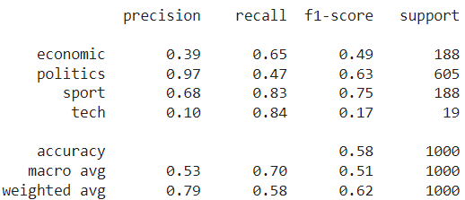
TF-IDF
Moderate Overall Performance:
Achieved moderate results across categories, indicating a decent baseline performance, while being particularly strong in terms recall, indicating its ability to identify relevant instances.
Category-Specific Challenges:
Struggled significantly with precision, especially in nuanced categories. For example, the ‘Tech’ category was particularly challenging, showing very low precision and f1-score which is probably due to the fact that there is only 92 training instances for the “Tech” class out of 4000 as well as having words rarely repeated as "غوغل“ is the most repeated word in the class with only 16 appearances, followed by "الذكاء“ which was repeated only 9 times.
Strengths:
High recall in categories like ‘Economic’ , ‘Sport’ and ‘Tech’, showing it can capture a broad range of relevant instances, along with being simple to implement and effective for initial exploration.
Weaknesses:
Poor precision in nuanced categories like ‘Tech’ and ‘Economic’, struggling with capturing the specific context and intricacies of text, since both of them have the lowest number of records.
Giving a low TF-IDF score the word “علي” because it is the most repeated token in all classes, meaning that it is not directly relevant to a specific class, while giving "مدريد“ a higher TF-IDF since it appears less and is correlated solely with the “Sport” category. This helps the model distinguish between what tokens are important and what are not.

Slide 47
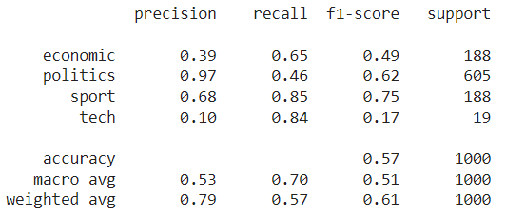
BoW
Moderate Overall Performance:
Exhibited results similar to TF-IDF with comparable strengths and weaknesses, and performed adequately in straightforward categories with clear language patterns.
Category-Specific Challenges:
Consistent performance in 'Sport’ but struggled with nuanced and complex categories like 'Tech’. Also, both precision and recall were inconsistent across different categories, reflecting challenges in accurate classification, which is due to the fact of solely capturing the frequencies of tokens in documents rather than considering the semantic relationships between them with the use of more advanced word representation techniques.
Strengths:
Effective in identifying instances in categories with less complexity, such as “Sports”, where words that are used in this class such as "مدريد“ and "برشلونة“ are very rarely used in other classes if ever, making use of the BoW simplifying assumption. It is also a very simple and straightforward approach, making it easy to implement and interpret.
Weaknesses:
Limited ability to handle nuanced language and complex patterns, as well as struggling with specific and detailed understanding of text, leading to inconsistent performance.

Slide 48
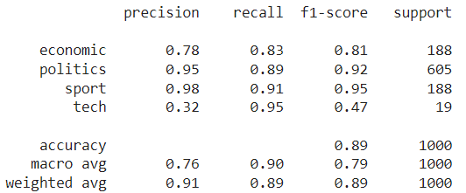
Word2Vec (Twitter)
Significant Improvement:
Outperformed traditional methods like TF-IDF and BoW and demonstrated high precision and recall, indicating a strong grasp of contextual meanings.
Category-Specific Challenges:
Excelling particularly in 'Sport’ with high precision and recall, as well as good performance across most categories, though still facing challenges in 'Tech’ probably due to the same reasons as mentioned previously.
Strengths:
Captures semantic relationships and contextual information effectively as well as being well-suited for handling colloquial language and formal text from social media.
Weaknesses:
Precision issues in 'Tech', indicating difficulty in specific classification, along with the fact that performance can vary depending on the domain specificity of the training data. Additionally, many words such as "االسعوديه“ resulted in OOV.

Slide 49
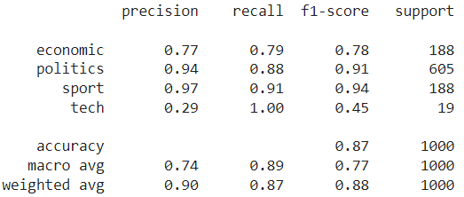
Word2Vec (Wikipedia)
Robust Performance:
Showed strong and balanced performance across multiple categories, and effective in 'Politics’ and 'Sport', providing a good balance of precision and recall.
Category-Specific Challenges:
While robust overall, struggled with specificity in the 'Tech’ category, where it accurately identified instances but had issues with precise classification, probably due to similar reasons as mentioned previously.
Strengths:
Versatile and robust, handling a wide range of topics and contexts, using high-quality embeddings due to the extensive and well-curated Wikipedia corpus.
Weaknesses:
Specificity issues in nuanced categories like 'Tech’, and performance may vary based on the diversity and complexity of the dataset. Additionally, it resulted in multiple OOV instances such as "االوحده“, which it cannot handle by itself and cannot provide the token with embeddings.

Slide 50
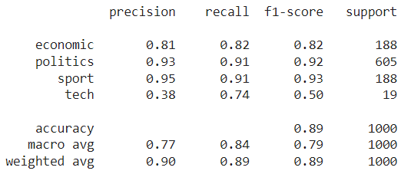
BERT
Top Performer:
Emerged as the most effective technique with balanced and robust performance, as it had high precision and recall in 'Economic', 'Politics', and 'Sport'.
Category-Specific Excellence:
Improved performance in the 'Tech’ category over all other word representations, reflecting better handling of minority classes. Also, it had superior contextual understanding and ability to capture nuanced relationships, meaning that it is better at predicting that sentences that contain "أبل“, "الذكاء“ and "الاصطناعي“ belongs to the “Tech” class, and that names of countries probably belongs to “Politics”.
Strengths:
Effective in capturing intricate and detailed relationships within text along with being flexible and adaptable to various NLP tasks, making it a versatile tool. It also has deep bidirectional understanding of context, leading to superior performance.
Weaknesses:
Resource-intensive, requiring significant computational power and memory, along with complexity in implementation and fine-tuning compared to simpler models.

Slide 51
Summary of Evaluation
TF-IDF and BoW: These techniques, although straightforward and computationally efficient, had limited capacity to grasp intricate semantic linkages in the text as they were less successful in obtaining high accuracy and F1-scores.
Word2Vec: Between the two versions (Twitter and Wikipedia), both managed to outperform significantly the traditional TF-IDF and BoW, yet the Twitter-trained embeddings showed the best performance among these conventional embeddings. What do we learn from this? This highlights how crucial it is that our training data be specific to the domain, only then can we expect any model to bloom with success.
BERT: BERT is now recognized as the best performer with respect to the highest precision, recall and F1-scores that it can offer. These capabilities are due to its ability to understand language at a deeper level than other models and effectively capture subtle linguistic nuances, allowing BERT to excel especially when faced with difficult classification tasks.

Slide 52
Final Thoughts
The results show that TF-IDF and Bag of Words (BoW) have both achieved close results in the evaluation metrics. Although the techniques have very high recalls, they lack precision, leading to low F1-scores. Although they were able to somewhat identify relevant terms, they still struggle with distinguishing between different classes of data leading for more false positives.
The Twitter-trained Word2Vec embeddings got the highest general precision and F1-score, which implies that this technique is better at interpreting the relationships between words and their meanings within a text. Even though not as good as the Twitter model, the Wikipedia-trained embeddings demonstrated good performance; while not outstanding, it still suggests that they are able to address different tasks with quality.
The performance of BERT was balanced across all the evaluation metrics which showed that it was able to achieve high accuracy and F1 score levels similar to the Word2Vec (Twitter) model. Nonetheless, BERT exhibited superior context comprehension as well as capability in dealing with imbalanced classes; this can be seen from its detailed performance statistics that gave more emphasis on minority classes. Therefore, these results point towards BERT being considered favorably for use in our NLP tasks as it shows strength in these areas where others may fall short.

Slide 53

Thank You!

